Slide 1
Advanced Data Centric Web Applications
Bachelor of Science (Honours) in Computing in Software Development
Bachelor of Science in Computing in Software
Development
Department of Computer Science & Applied Physics

Slide 2
Injecting Lists of Beans
Lists (of Strings, Integers, objects etc.) can be injected into beans.
public class Student {
private String name;
private List<Module> modules;
public Student(String name,
List<Module> modules) {
super();
this.name = name;
this.modules = modules;
}
public class Module {
private String moduleName;
private int credits;
private boolean allCA;
public Module(String moduleName, int credits,
boolean allCA) {
this.moduleName = moduleName;
this.credits = credits;
this.allCA = allCA;
}

Slide 3
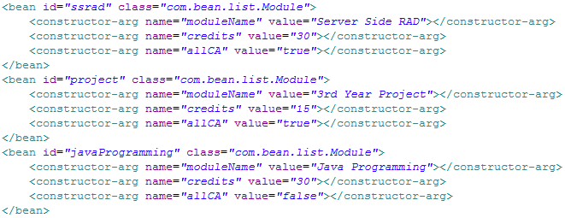
Injecting Lists of Beans - Steps
Create the Module beans

Slide 4
Injecting Lists of Beans - Steps
Create the Student bean.
First just make the constructor arg for the
name parameter.

Slide 5
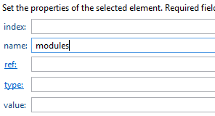
Injecting Lists of Beans - Steps
Add the modules constructor-arg parameter to the Student bean.
However, the ref and value fields should be
left blank.

Slide 6
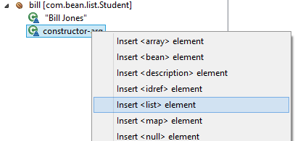
Injecting Lists of Beans - Steps
Right-click on the modules constructor-arg and select Insert <list> element.
This is because the modules constructor-arg
expects a list to be passed to it.

Slide 7
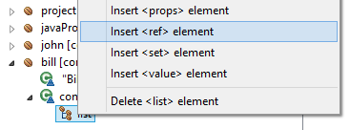
Injecting Lists of Beans - Steps
Right-click on the list part of the modules constructor-arg and select Insert <ref> element.

Slide 8
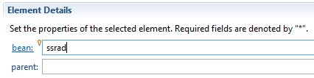
Injecting Lists of Beans - Steps
Add the name of one of the Module beans to the list.
Continue to add as many more <ref>
elements to the modules list as needed.

Slide 9
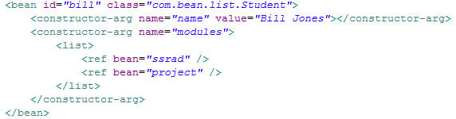
Injecting Lists of Beans - Steps
The full xml of the Student bean just created will look as follows:

Slide 10
Dynamic Constructor Args
Person
public class Person {
private String name;
private int age;
public Person(String name,
int age) {
this.name = name;
this.age = age;
}
In this setup, we have to know the constructor arguments before run-time.
If we want to create a number of different Persons we must create a number of different beans.
What happens if we want the Person’s name and age to be provided at run-time?
beans.xml
<bean id="person" class="com.bean.factory.Person">
<constructor-arg name="name" value="Donald"></constructor-arg>
<constructor-arg name="age" value="21"></constructor-arg>
</bean>

Slide 11
Dynamic Constructor Args
We use a Factory Design pattern to create objects/beans.
The Factory Design pattern allows the creation of an object without exposing the creation logic to the client.

Slide 12
Factory Design Pattern Recap No Factory Example
Animal
public interface AnimalI {
boolean canFly();
int getNumberOfLegs();
}
Robin
public class Robin implements AnimalI {
@Override
public boolean canFly() {
return true;
}
@Override
public int getNumberOfLegs() {
return 2;
}
}
Dog
public class Dog implements AnimalI {
private String name;
@Override
public boolean canFly() {
return false;
}
@Override
public int getNumberOfLegs() {
return 4;
}
public Dog(String name) {
this.name = name;
}
}

Slide 13
Factory Design Pattern Recap No Factory Example
Main
public class Main {
public static void main(String[] args) {
Robin r = new Robin();
System.out.println(r.canFly());
Dog d = new Dog("Rex");
System.out.println(d.canFly());
}
}
Robin
public class Robin implements AnimalI {
@Override
public boolean canFly() {
return true;
}
@Override
public int getNumberOfLegs() {
return 2;
}
}
Dog
public class Dog implements AnimalI {
private String name;
@Override
public boolean canFly() {
return false;
}
@Override
public int getNumberOfLegs() {
return 4;
}
public Dog(String name) {
this.name = name;
}
}

Slide 14
Factory Design Pattern Recap Factory Example
Animal
public interface AnimalI {
boolean canFly();
int getNumberOfLegs();
}
Robin
public class Robin implements AnimalI {
@Override
public boolean canFly() {
return true;
}
@Override
public int getNumberOfLegs() {
return 2;
}
}
Dog
public class Dog implements AnimalI {
private String name;
@Override
public boolean canFly() {
return false;
}
@Override
public int getNumberOfLegs() {
return 4;
}
public Dog(String name) {
this.name = name;
}
}

Slide 15
Factory Design Pattern Recap Factory Example
AnimalFactory
public class AnimalFactory {
public Animal getAnimalInstance(String animal) throws AnimalException {
switch (animal) {
case "Robin":
return new Robin();
case "Dog":
return new Dog("Benji");
default:
throw new AnimalException("Unknown Animal");
}
}
public Animal getAnimalInstance(String animal, String animalName) throws AnimalException {
switch (animal) {
case "Robin":
throw new AnimalException("Robin does not have a name");
case "Dog":
return new Dog(animalName);
default:
throw new AnimalException("Unknown Animal");
}
}

Slide 16
Factory Design Pattern Recap Factory Example
Main
public class Main {
public static void main(String[] args) throws AnimalException {
AnimalFactory af = new AnimalFactory();
Animal r = af.getAnimalInstance("Robin");
System.out.println(r.canFly());
Animal d1 = af.getAnimalInstance("Dog");
System.out.println(d1.canFly());
Animal d2 = af.getAnimalInstance("Dog", "Rex");
System.out.println(d2.canFly());
}
}

Slide 17
Factory Design Pattern Recap Factory Method
Instead of whole separate class for factory (Factory Class), a Factory Method is a method in the class that acts as a factory.

Slide 18
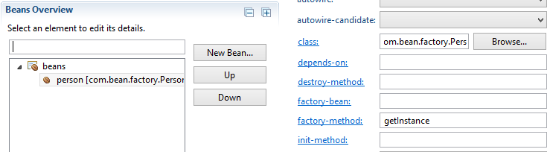
Dynamic Constructor Args
Person
public class Person {
private String name;
private int age;
private Person(String name,
int age) {
this.name = name;
this.age = age;
}
Person
public static Person getInstance() {
System.out.println("Enter name: ");
Scanner sc=new Scanner(System.in);
String name=sc.nextLine();
System.out.println("Enter age: ");
int age=sc.nextInt();
return new Person(name, age);
}

Slide 19
Dynamic Constructor Args
The factory-method will be called instead of the bean constructor.
The factory-method must be static.

Slide 20
AutoWiring
Dependency Injection is also called Wiring.
Spring provides autowiring, which means beans are automatically linked together by Spring, without the need for using constructor-arg and/or property elements.
Autowiring cuts down on the amount of XML needed to be configured.
There are different ways (modes) in which Spring autowires applications.

Slide 21
Autowiring Example
Person
public class Person {
private String name;
private Address address;
private Car car;
public Person(String name) {
this.name = name;
}
public void setAddress(Address
address){
this.address = address;
}
public void setCar(Car car) {
this.car = car;
}
Address
public class Address {
private String street;
private String town;
private String county;
public Address(String street, String town,
String county) {
this.street = street;
this.town = town;
this.county = county;
}
Car
public class Car {
private String reg;
private double engineSize;
public Car(String reg, double engineSize) {
this.reg = reg;
this.engineSize = engineSize;
}

Slide 22
AutoWiring – default/No
Default autowiring in Spring is to have none.
This means bean references should be explicitly set.

Slide 23
AutoWiring – byName
Autowiring by property/attribute name – Not constructor-arg name.
Must have associated setter methods, of the correct names, for properties/attributes.
Spring looks at the properties/attributes of the beans on which autowire attribute is set to byName in the XML configuration file.

Slide 24
AutoWiring – byName
It then tries to match and wire the bean’s properties/attributes with existing beans of the same names as the properties/attributes in the configuration file.
If no bean matching the name of a property is found, the setter for that property will not be called.
If no matching setter method (of the expected name) is found, the property will not be set.
E.g. if the bean is called “car” the setter method must be called setCar.

Slide 25
AutoWiring – byType
Autowiring by property type – Not constructor-arg type.
Must have associated setter methods, of the correct types, for properties.
Spring looks at the properties of the beans on which autowire attribute is set to byType in the XML configuration file.
It then tries to match and wire its properties with existing beans of the same types in the configuration file.

Slide 26
AutoWiring – byType
If no bean matching the property type is found, the setter for that property will not be called.
If more than one such beans exists, a fatal exception is thrown.
If no matching setter method (of the expected type) is found, the property will not be set.
E.g. If the bean is of type com.auto.Car a setter method with a parameter of type com.auto.Car will be required, public void set…(Car myCar)

Slide 27
AutoWiring – byType
If multiple matching setter methods (of the expected type) are found, each of these methods will be called in alphabetical order.
E.g. if the bean is called “car” and there are two setter methods:
public void setCarZZZ(Car car) { public void setCarYYY(Car car) {
this.car = car; this.car = car;
} }
setCarYYY() will be called first, then setCarZZZ()

Slide 28
AutoWiring – constructor
Autowiring by constructor-arg type.
Similar to byType but applies to constructor-args.
Spring looks at the constructor-args of the beans on which autowire attribute is set to constructor in the XML configuration file.
It then tries to match and wire its constructor-args with existing beans of the same types in the configuration file.

Slide 29
AutoWiring – constructor
If no bean of a required type is found an exception is thrown.
If multiple beans of the same type are found, the one which matches the Constructor-arg name is used.
If multiple beans of the same type are found, and none matches the Constructor-arg name, an exception is thrown.

Slide 30
AutoWiring - Limitations
Primitive data types (int, String etc.) cannot be autowired.
If dependencies are specified using the constructor-arg this will override autowiring.
If dependencies are specified using the property they will be set after autowiring.

